Slide 1
MULTI-AGENT SOC ALERT TRIAGE
and Incident Response Assistant
Presented by Dakshesh Chauhan and Bhavya Tanna
CA-3 Agentic AI Proof of Concept · SIT Pune
Subject faculty: Prof. Harshal Raut
Notes:
About 20 seconds. Introduce both team members and say who built which part. One-line hook: a SOC gets more alerts than analysts can read, so we built six agents that triage them and a Critic that checks their work.

Slide 2
PROBLEM STATEMENT
Domain: Cybersecurity Operations (SOC)
Alert fatigue. A Security Operations Centre gets far more alerts than analysts can read. Real attacks are spread across several alerts, hosts and minutes, so each one looks harmless alone and attacks are found late.
Why agents, not a chatbot. Triage means grouping, enriching, correlating, scoring and writing rules. A chatbot cannot call tools, is not checked, and may invent indicators. We use six agents and a Critic that validates every result.
Notes:
About 35 seconds. Explain alert fatigue in one breath. Then say why this needs agents: separate steps, branching decisions, and a validator. A plain chatbot cannot call tools and its answers are unchecked.

Slide 3
PROJECT SCOPE
Objectives
Show five agentic behaviours: task planning, tool execution, decision-making, validation and agent collaboration
Run free and local: Python, LangGraph and Ollama (llama3.2 3B), no paid API
Keep a human in the loop and measure results against ground truth
In scope: synthetic alerts, a Windows Security and Sysmon sample, mock integrations, a local web console
Out of scope: real SIEM, real threat-intel feeds, real containment actions, deployment
Notes:
About 25 seconds. The brief asks for planning, tool execution, decision-making, validation and collaboration. We map each to a part of the system. Everything is free and local, and all data is synthetic.

Slide 4
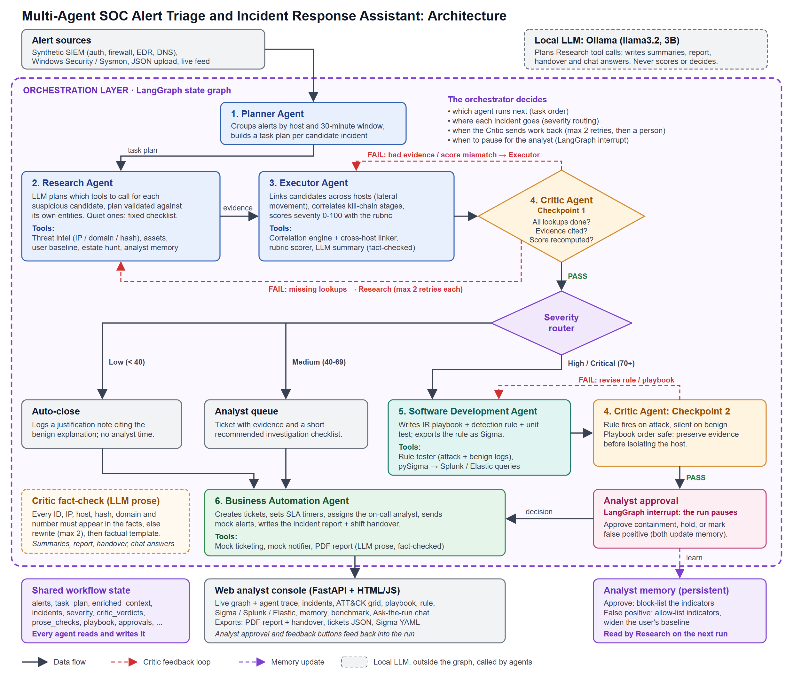
SYSTEM ARCHITECTURE
One LangGraph state graph runs all six agents over one shared state
A local LLM plans and writes prose; Python decides every score and route
Two Critic checkpoints send faulty work back, up to 2 retries
An analyst approves containment before any action
Notes:
About 40 seconds. Trace one incident along the diagram: alerts enter at the top, go through Planner, Research and Executor, then Critic checkpoint 1. The severity router sends low incidents to auto-close, medium to the analyst queue and high through the Software Development agent and Critic checkpoint 2. The red dashed lines are Critic retries. The LLM sits outside the graph and never decides.

Slide 5
THE SIX AGENTS
Planner
Groups alerts by host and time into candidate incidents
Research
Threat-intel, asset and user lookups, planned by the LLM and validated by Python
1
2
Executor
Correlates kill-chain stages and scores severity from 0 to 100
Critic
Re-checks evidence, score, rule and playbook; sends work back
3
4
Software Development
Writes the playbook, detection rule, unit test and Sigma export
Business Automation
Opens the ticket, sets the SLA, notifies, writes the report
5
6
Notes:
About 40 seconds. All six roles from the brief are used. Planner, Research and Executor investigate; the Critic validates; Software Development writes the playbook and detection rule; Business Automation handles tickets, notifications and the report. Only Research and the report writers use the LLM, and the Critic fact-checks everything it writes.

Slide 6
HOW IT WORKS
Plan and enrich. The Planner groups 153 alerts into 45 candidate incidents. Research lets the LLM plan lookups; Python rejects any tool or indicator it invented.
Correlate, score, route. The Executor links kill-chain stages across hosts and scores 0 to 100. Below 40 auto-close, 40 to 69 analyst queue, 70 and above a playbook and Sigma rule.
Validate and approve. The Critic checks evidence, score, rule and playbook, and fact-checks every LLM sentence. An analyst approves containment, then the run resumes.
Live demo: the full run takes about 97 seconds on a laptop CPU
Notes:
About 45 seconds, then switch to the live demo. Start Ollama before presenting. In the demo: set fault injection to Critic loops, press Run, and point at the trace when Critic checkpoint 1 rejects a missing lookup and only that lookup reruns. Then approve containment for INC-002 (severity 95) when the run pauses.

Slide 7
THE CRITIC
CRITIC ON
0/42
Re-derives, never trusts. Lookups, evidence IDs and severity are recomputed from the raw alerts. A failure goes back to the agent that made it, with at most 2 retries.
injected faults reach the output when the Critic is enforcing
Checks the code too. A detection rule must fire on the attack and stay silent on benign logs. A playbook must preserve evidence before isolating a host.
CRITIC OFF
42/42
Fact-checks every LLM sentence. Any ID, IP address, host or number not in the facts is rejected and rewritten.
injected faults reach the output when the Critic is disabled
Notes:
About 40 seconds. This is the ablation: we injected 42 faults, 7 types times 6 runs. With the Critic enforcing, all 42 were caught and corrected by a retry. With it disabled, all 42 reached the final output: wrong scores, invented kill-chain stages, rules that fire on benign logs, and playbooks that isolate a host before preserving evidence.

Slide 8
RESULTS AND EVALUATION
4 of 4 attack chains found on the 153-alert demo dataset; 0 of 127 benign alerts escalated
Precision, recall and F1 all 1.0; 3 of 3 generated detection rules passed their tests
57 of 60 chains found across 15 datasets; the 3 misses scored 65 and still reached the analyst queue
Real Ollama run: 97 s on a laptop CPU, with one Critic retry at each checkpoint
Notes:
About 35 seconds. The demo dataset has four hidden attack chains in 127 benign alerts. All four were found and none of the benign alerts was escalated. Across 15 generated datasets we found 57 of 60 chains; the three misses are one case where phishing lands on a low-criticality host and scores 65. Be upfront that these are scripted attacks.

Slide 9

LIMITATIONS AND FUTURE WORK
Limitations
Future work
Scripted synthetic attacks; the Windows sample is small and hand-written
Fixed correlation rules and rubric weights
Mock threat intel, ticketing and notifications
A 3B model writes plain prose; the fact-check blocks invented facts
Connect a real SIEM and threat-intel source such as MISP
Evaluate on public datasets such as OTRF Security-Datasets
Learn rubric weights from analyst verdicts
Add authentication, stored runs and role-based approval
Notes:
About 25 seconds. Be honest: the strong scores come from scripted attacks that the correlation rules were written to recognise. They show the pipeline works end to end, not that it would catch a new technique. Next steps are a real SIEM, public datasets, learned rubric weights and authentication.

Slide 10
THANK YOU
Presented by Dakshesh Chauhan and Bhavya Tanna
Source code: github.com/da-ksh-esh/SOCAgent
Notes:
Close in about 10 seconds and invite questions. Both team members should be ready to answer on any agent, the orchestration graph, the severity rubric and the validation checks.

